Slide 1




Le MLOps est avant tout une aventure humaine
Guillaume Chervet
TechLead – ML Engineer @guiChervet

Slide 2
Software Engineer
Datascientist
Ops

Slide 3
Email classification
Train env on AzureML | Prod env | Total default run cost
2700 € by month | 6000 € by month (dev, staging, pre-prod, prod) | 8 700 € by month
Notes:
On parle de 3 000 000 mail par ans
10 000 jours
250 000 mois
3 centime la classification de mail
40 000 Euros environ pour un réentrainement par ans donc environ 1 centime plus soit 4 centime
150 000 Euro par ans
Sachant que les taux de prédictions ne sont pas parfait => cout induit
Plus cout de gestion de la production
POC 300 000 Euros
1, 2 millions de projet si 5 personnes a temps plein sur 2 ans
Projet sans annotation => on est parti d’un système qui classifie déjà apprentissage sur 55 000 mails cout annotation 300 / jours 183 jour * 300 => 55 000 € euros

Slide 4

Classification
Sinistres Contrat
Facture
Pièce de gestion
Autres
email
"envelope uppside an old white paper"

Slide 5
Introduction to AI and Deep Learning
What do we expect of a project in production ?
Recipes to fail the project ?
How to put the odds in your favor ?

Slide 6
Introduction to AI and Deep Learning
What do we expect of a project in production ?
Recipes to fail the project ?
How to put the odds in your favor ?

Slide 7
Deep Learning
Artificial Intelligence
Machine Learning
Deep Learning

Slide 8
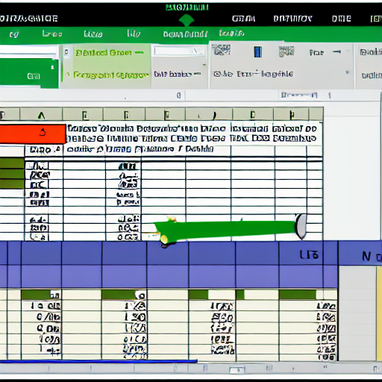
Deep Learning
Structured data
"excel structured data"

Slide 9


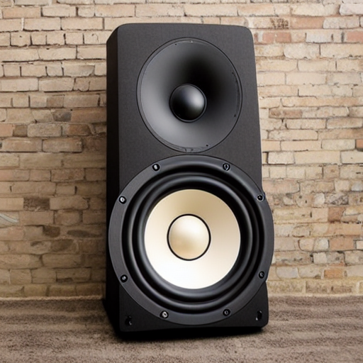
Deep Learning
Unstructured data
"text from an old book on a table"
"camera outside on the beach"
"big music speaker"

Slide 10


Deep Learning
Classical programming
Rules
Answers
Data
Machine Learning
Data
Rules
Answers
Source : François Chollet

Slide 11
Deep Learning
Code
Input
Output
AI model
Input
Output

Slide 12

Data is gold
Deep Learning
(Data centric)

Slide 13
Deep Learning
collect
Datasets

Slide 14
Deep Learning
collect
Datasets
use
Train IA

Slide 15
Deep Learning
collect
Datasets
use
Train IA
deploy
Production AI API

Slide 16
Deep Learning
collect
Datasets
use
Train IA
deploy
Production AI API
use
Consumer Production application

Slide 17
Deep Learning
collect
Datasets
use
Train IA
deploy
Production AI API
use
Consumer Production application
collect
Feedback Loop

Slide 18
Demo
Deep Learning
Source :
Dogs vs. Cats | Kaggle

Slide 19
Dataset of 20 000 files
Deep Learning
Train a model
13 000 train
4 000 test
3 000 validation

Slide 20
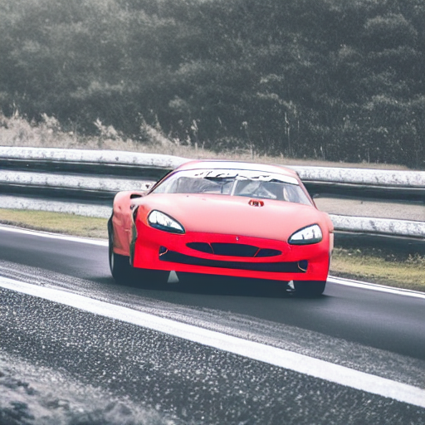
Datadrift
Deep Learning
"a race car drift deep on a road in a bend"

Slide 21

Deep Learning
"the god graal trophy"
Notes:
C’est quoi le graal ?

Slide 22
Deep Learning
Configuration
Data Collection
Data Verification
Machine Resource Management
Serving Infrastructure
Monitoring
ML Code
Analysis Tools
Feature Extraction
Process Management Tools
Source : google, formation MLOps Coursera

Slide 23
Introduction to AI and Deep Learning
What do we expect of a project in production ?
Recipes to fail the project ?
How to put the odds in your favor ?

Slide 24
Production
Answer to users needs
Good AI prediction
Cheap
Fast
Secured
Monitored (datadrift)
Fast retrain/deployment

Slide 25

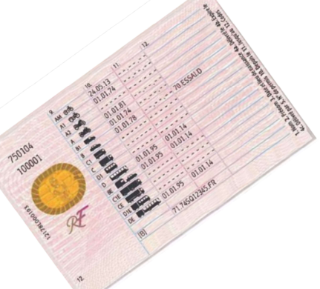



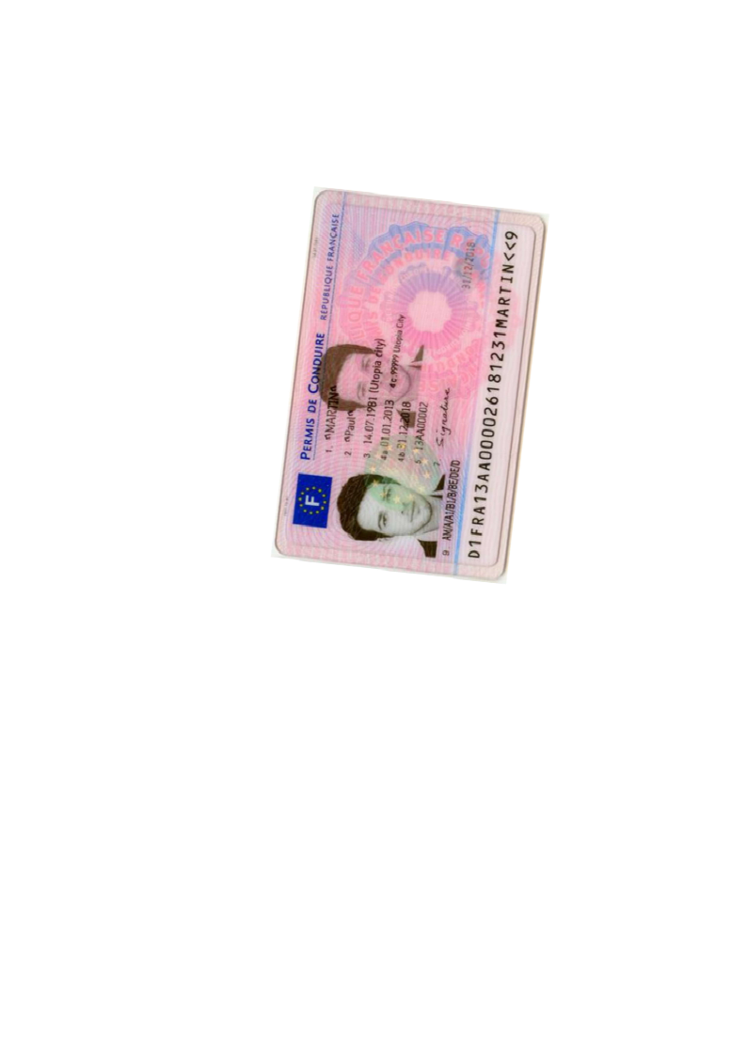
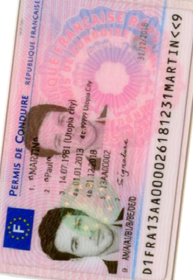
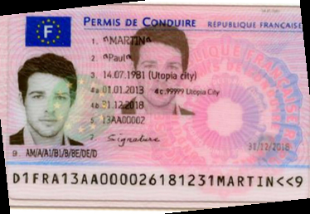
Production
Page
Zoning
Homography
Zoning
Zoning
OCR
OCR
Split
Split
Zoning
Homography
Zoning
OCR
Legend :
ML + code
Only code
Notes:
Guillaume
10 mins

Slide 26


Production
input
output
Function
Queue A
Queue B

Slide 27
Function
Production
Function
input
output
Queue A
Function
Queue B
Function

Slide 28
PDF, IMAGES
JSON Response
OCR
Input HTTP call
HTTP Callback
Receiver
Orchestrator
Queue
Nouveau permis recto
Queue
Homographie
Zoning
Queue
Queue
Splitter
Zoning Tableau
Nouveau permis verso
Queue
Homographie
Zoning
Rotation Tableau
Queue
Queue
Queue
Zoning
Queue
Ancien permis recto
Homographie
Zoning
Classifier Tableau
Rotation Tableau
Queue
Queue
Queue
Queue
Production

Slide 29
Difficulties
Production

Slide 30
Quicker response
Production : Difficulties
Better prediction
Cheaper

Slide 31
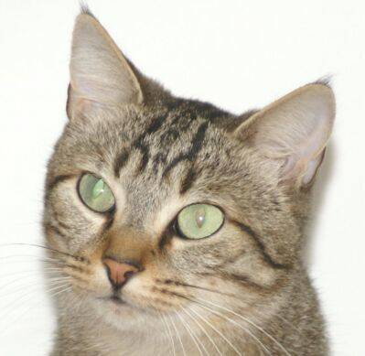
Find 7 differencies
Production : Difficulties

Slide 32
Production : Difficulties
Page
Zoning
Homography
Zoning
Zoning
OCR
OCR
Split
Split
Zoning
Homography
Zoning
OCR
Legend :
ML + code
Only code
Notes:
Guillaume
10 mins

Slide 33
Introduction to AI and Deep Learning
What do we expect of a project in production ?
Recipes to fail the project ?
How to put the odds in your favor ?

Slide 34

Recipes to fail
Exploration
"Data scientist girl who cook with a suit in a kitchen, artstation concept art"
Project timeline
Notes:
Exemple avec les rôles qui interviennent sur RAMI
Exemple aussi sur Clear
Exemple Carto

Slide 35
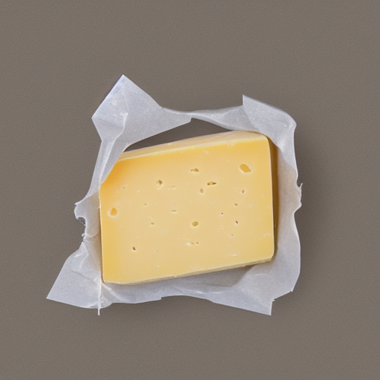
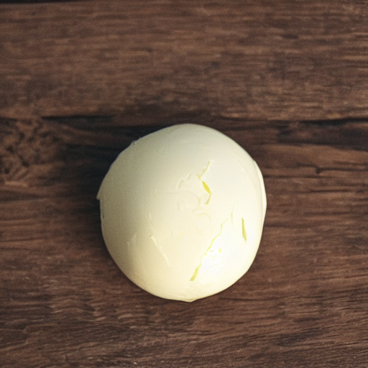
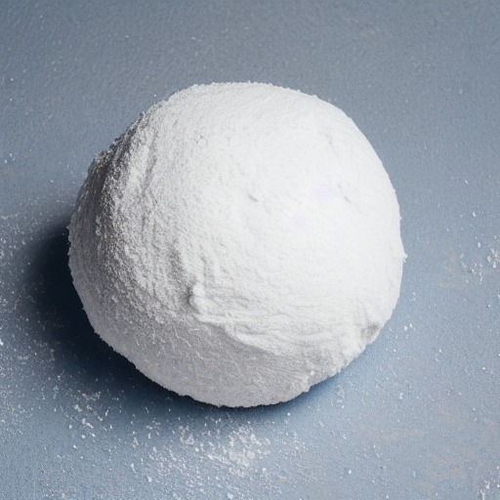
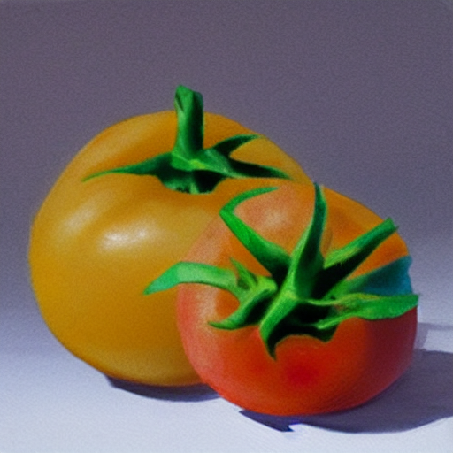
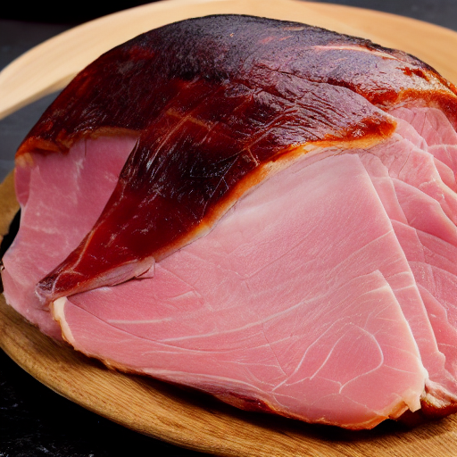
Recipes to fail
Exploration
"Data scientist girl who cook with a suit in a kitchen, artstation concept art"
Project timeline
Notes:
Exemple avec les rôles qui interviennent sur RAMI
Exemple aussi sur Clear
Exemple Carto

Slide 36
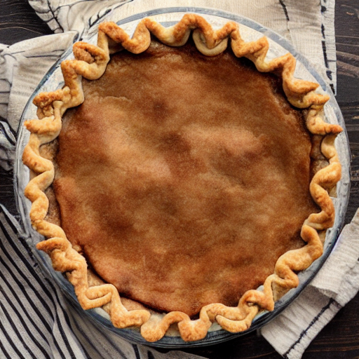
Recipes to fail
Exploration
"Data scientist girl who cook with a suit in a kitchen, artstation concept art"
Project timeline
Notes:
Exemple avec les rôles qui interviennent sur RAMI
Exemple aussi sur Clear
Exemple Carto

Slide 37

Recipes to fail
Exploration
Industrialisation
"Data scientist girl who cook with a suit in a kitchen, artstation concept art"
"Developer waiter in t-shirt in a restaurant , artstation concept art"
Project timeline
Notes:
Exemple avec les rôles qui interviennent sur RAMI
Exemple aussi sur Clear
Exemple Carto

Slide 38
Recipes to fail
Exploration
Industrialisation
Hop
"Data scientist girl who cook with a suit in a kitchen, artstation concept art"
"Developer waiter in t-shirt in a restaurant , artstation concept art"
Project timeline
Notes:
Exemple avec les rôles qui interviennent sur RAMI
Exemple aussi sur Clear
Exemple Carto

Slide 39
Recipes to fail
Exploration
Industrialisation
"Developer waiter in t-shirt in a restaurant , artstation concept art"
Project timeline
Notes:
Exemple avec les rôles qui interviennent sur RAMI
Exemple aussi sur Clear
Exemple Carto

Slide 40
Recipes to fail
Exploration
Industrialisation
Deployment & run
"Developer waiter in t-shirt in a restaurant , artstation concept art"
Project timeline
Notes:
Exemple avec les rôles qui interviennent sur RAMI
Exemple aussi sur Clear
Exemple Carto

Slide 41

Recipes to fail
Exploration
Industrialisation
Deployment & run
"Developer waiter in t-shirt in a restaurant , artstation concept art"
"Man who washes dishes in a kitchen, artstation concept art"
Project timeline
Notes:
Exemple avec les rôles qui interviennent sur RAMI
Exemple aussi sur Clear
Exemple Carto

Slide 42
Recipes to fail
Exploration
Industrialisation
Deployment & run
Hop
"Developer waiter in t-shirt in a restaurant , artstation concept art"
"Man who washes dishes in a kitchen, artstation concept art"
Project timeline
Notes:
Exemple avec les rôles qui interviennent sur RAMI
Exemple aussi sur Clear
Exemple Carto

Slide 43
Recipes to fail
Exploration
Industrialisation
Deployment & run
"Man who washes dishes in a kitchen, artstation concept art"
Project timeline
Notes:
Exemple avec les rôles qui interviennent sur RAMI
Exemple aussi sur Clear
Exemple Carto

Slide 44
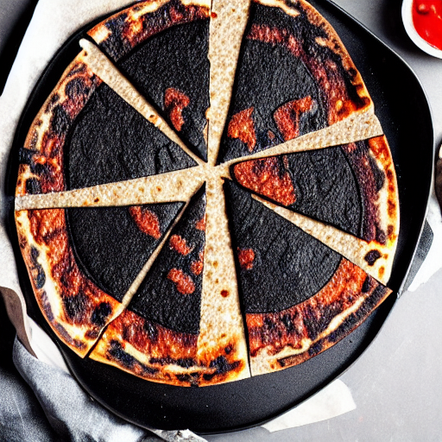
Recipes to fail
Exploration
Industrialisation
Deployment & run
"Man who washes dishes in a kitchen, artstation concept art"
Project timeline
Notes:
Exemple avec les rôles qui interviennent sur RAMI
Exemple aussi sur Clear
Exemple Carto

Slide 45
Recipes to fail
Exploration
Industrialisation
Deployment & run
Do not organize your teams to work together at the same time !
"Data scientist girl who cook with a suit in a kitchen, artstation concept art"
"Developer waiter in t-shirt in a restaurant , artstation concept art"
"Man who washes dishes in a kitchen, artstation concept art"
Project timeline
Notes:
Exemple avec les rôles qui interviennent sur RAMI
Exemple aussi sur Clear
Exemple Carto

Slide 46

Forget that data is gold
"a man carrying a big bag"

Slide 47
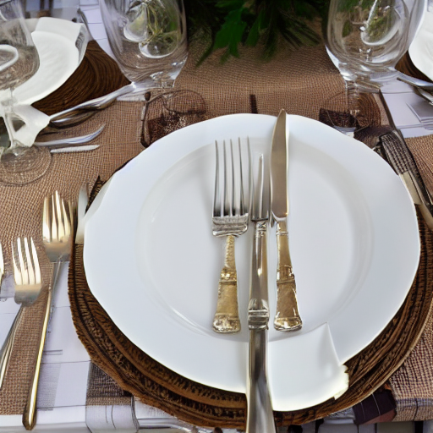
Do not focus on the needs
Recipes to fail
"set table with glass plates and cutlery on a table"
Notes:
Lire tous les champs alors que seul 6 demandé premier consommateur
- Histoire du splitter

Slide 48
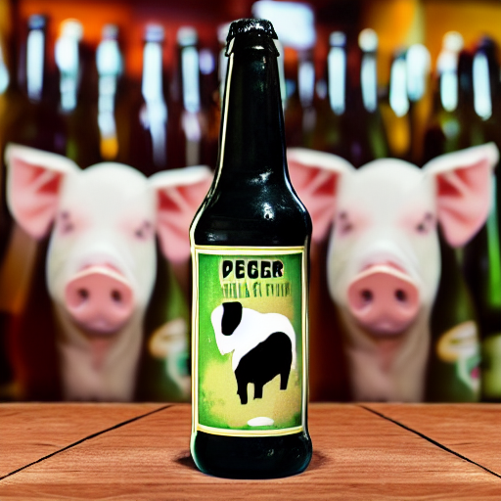
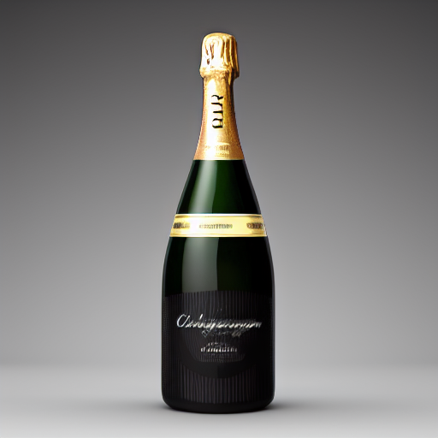
Use Deep Learning Everywhere
Recipes to fail
Deep Learning
Code classique
"bottle of beer with a pig on the label"
"bottle of champagne gold"
Notes:
Tester les modèles générique déjà pré-entrainer sur internet
GPU en production
Code classique
Itération rapide
Résilient aux changements de la données
Peux couteux en temps/RAM/CPU
Ne pourra pas couvrir 100% des cas
Réutilisable
Algorithmes pas tous déterministe
Deep Learning :
Itération très longue
Peu résilient aux changements
Couteux en temps/RAM/CPU
Permet de tendre vers une couverture fonctionnelle de 100% des cas

Slide 49
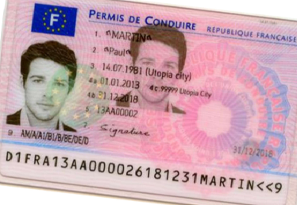
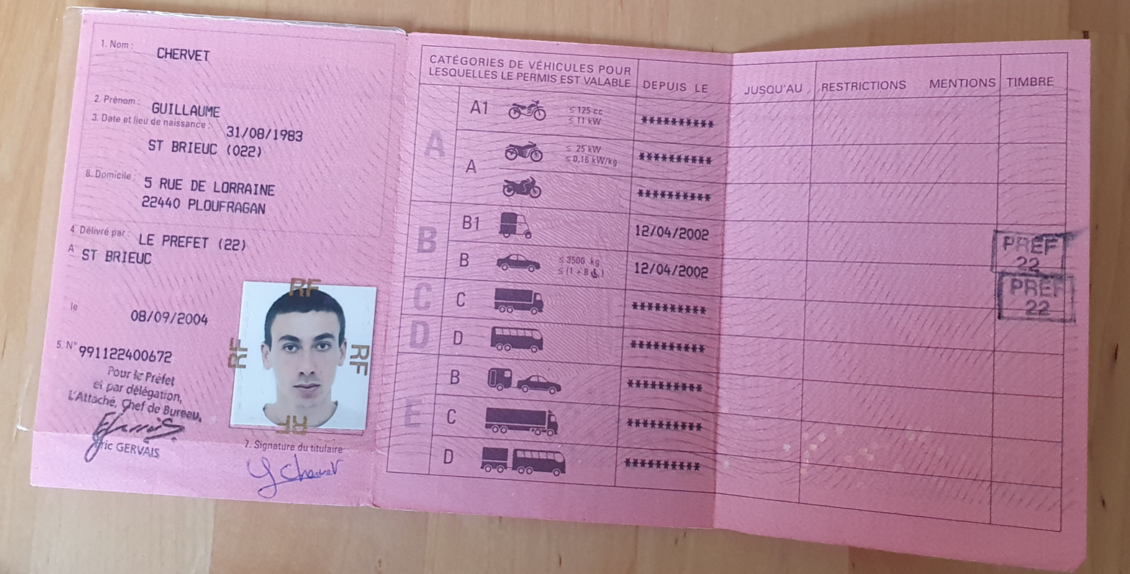
Use Deep Learning Everywhere
Recipes to fail
4 Go
5,5 Go
512 Mo
Orientation
Rotation
Homography
1 s
3 s
0,5 s
4 Go
5,5 Go
512 Mo
Orientation
Rotation
Homography
1 s
3 s
0,5 s
5,5 Go
512 Mo
Legend :
Orientation
Homography
ML + code
1 s
0,5 s
Only code
Notes:
Guillaume
10 mins

Slide 50
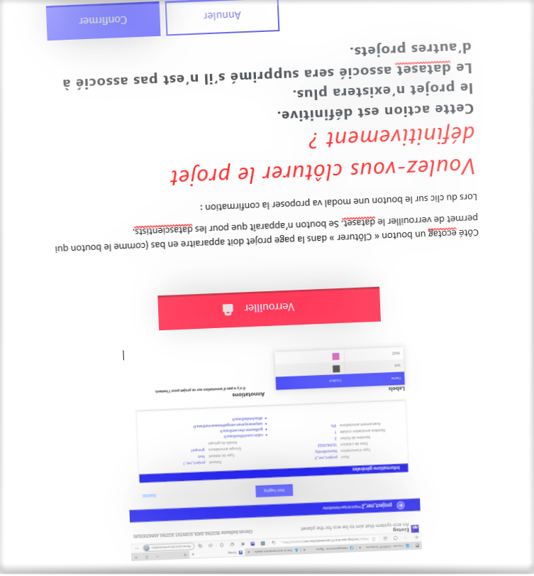
Use Deep Learning Everywhere
Recipes to fail

Slide 51
Use Deep Learning Everywhere
Recipes to fail
Zoning
Zoning

Slide 52
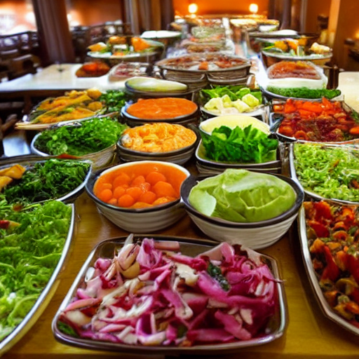
Recipes to fail
"salad buffet in a restaurant"
Do not industrialize the training code

Slide 53
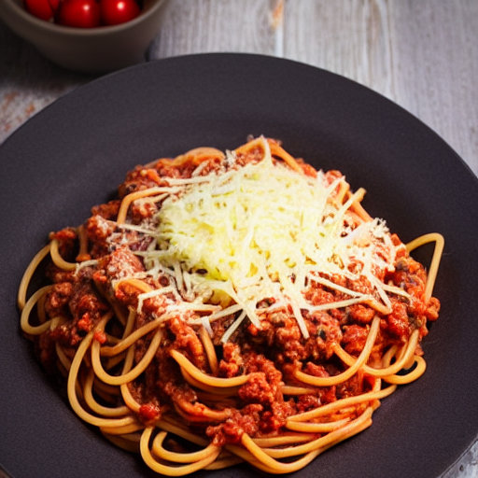
Recipes to fail
No code quality
Bolognese spagetti plate with cheese
Notes:
pas de test unitaire
Clean code

Slide 54
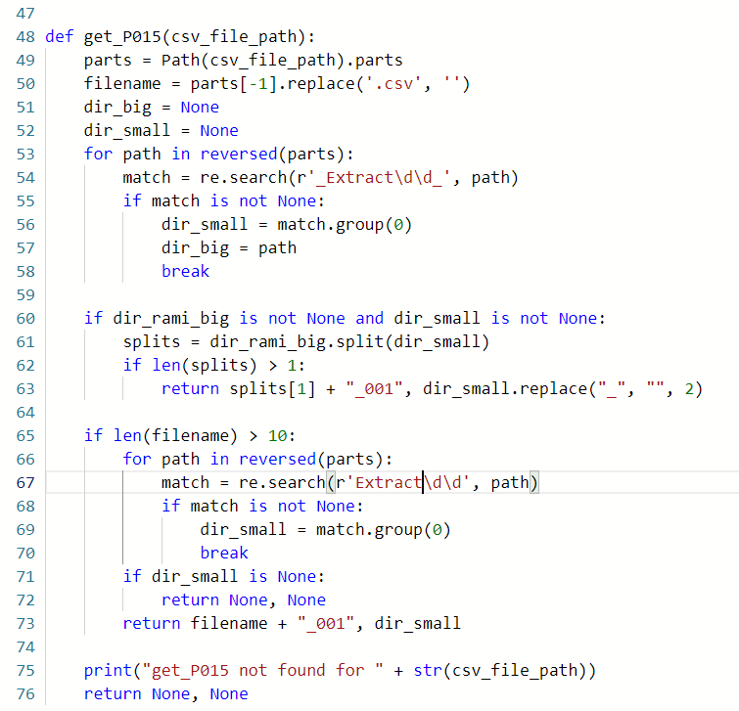
Recipes to fail

Slide 55
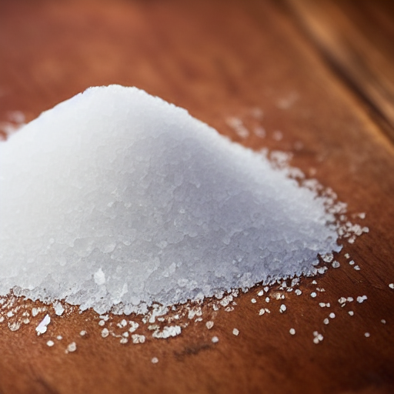

Recipes to fail
"a pinch of salt"
Split train and production code on different git
Notes:
Pas le même code de préprocessing
Dupliquer le code

Slide 56
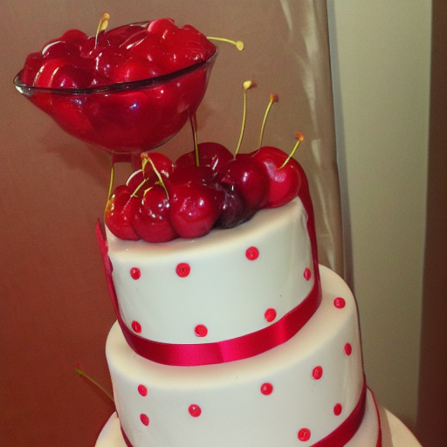
Do not monitor data drift
Recipes to fail
"cherry on the cake"

Slide 57

Only focus on statistics
"one coffee on a table"

Slide 58
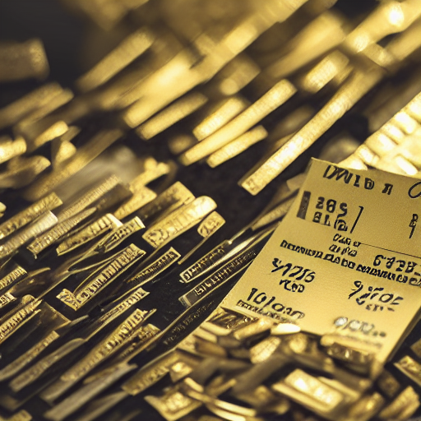
Do not do FinOps PlanetOps
Recipes to fail
"invoice made of gold"
Notes:
Se focaliser sur la data
pas de métriques clair
se focaliser sur les statistiques

Slide 59
Introduction to AI and Deep Learning
What do we expect of a project in production ?
Recipes to fail the project ?
How to put the odds in your favor ?

Slide 60
Exploration phase
Recipes to win

Slide 61
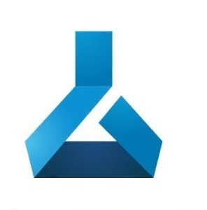


Exploration phase
Recipes to win
AzureML dev
Annotations
+
Data
Automated Training Pipeline
Model Registry

Slide 62

Exploration phase
Recipes to win
AzureML dev
Annotations
+
Data
Automated Training Pipeline
Data Validation
Data Preparation
Model Training
Model Evaluation
Model Registry
Model Register

Slide 63
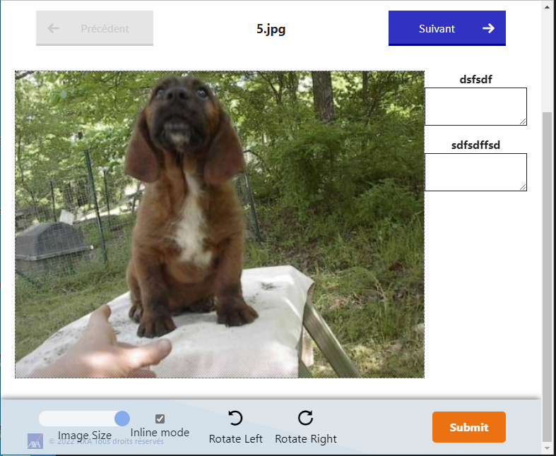
Exploration phase
Recipes to win
Ecotag
AzureML dev
Annotations
+
Data
Automated Training Pipeline
Data Validation
Data Preparation
Model Training
Model Evaluation
Model Registry
Model Register

Slide 64
Exploration phase
Recipes to win
AzureML dev
Annotations
+
Data
Automated Training Pipeline
Data Validation
Data Preparation
Model Training
Model Evaluation
Model Registry
Model Register

Slide 65
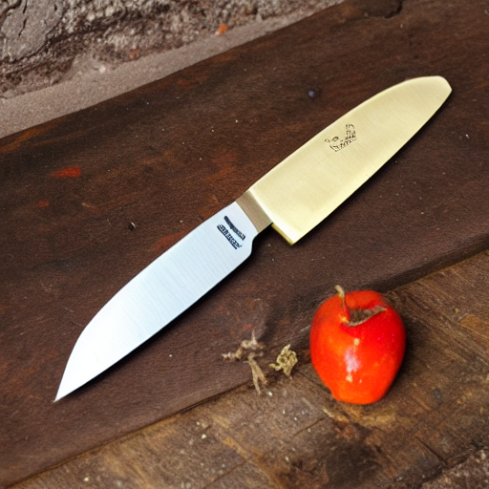
Exploration phase
Recipes to win
AzureML dev
Annotations
+
Data
Automated Training Pipeline
Data Validation
Data Preparation
Model Training
Model Evaluation
Model Registry
Model Register
AI metrics
Estimate production cost
Estimate response time
Train code

Slide 66
Industrialisation phase
Recipes to win

Slide 67
Recipes to win
AzureML dev
Automated Training Pipeline
Data Validation
Data Preparation
Model Training
Model Evaluation
Model Registry
Model Register
Industrialisation phase

Slide 68
Recipes to win
AzureML dev
Automated Training Pipeline
Data Validation
Data Preparation
Model Training
Model Evaluation
Model Registry
Model Register
Industrialisation phase

Slide 69

Recipes to win
AzureML dev
Automated Training Pipeline
Data Validation
Data Preparation
Model Training
Model Evaluation
Model Registry
Model Register
Docker registry
Industrialisation phase

Slide 70

Recipes to win
AzureML dev
Automated Training Pipeline
Data Validation
OpenShift dev
Data Preparation
Model Training
zoning
ocr
homography
Model Evaluation
Model Registry
Model Register
OpenShift rec
zoning
ocr
homography
Docker registry
Industrialisation phase

Slide 71
Recipes to win
AzureML dev
Automated Training Pipeline
Data Validation
OpenShift dev
Data Preparation
Model Training
zoning
ocr
homography
Model Evaluation
Model Registry
Model Register
OpenShift rec
zoning
ocr
homography
Docker registry
Industrialisation phase

Slide 72
Recipes to win
AzureML dev
Automated Training Pipeline
Data Validation
OpenShift dev
Data Preparation
Model Training
zoning
ocr
homography
Model Evaluation
Model Registry
Model Register
OpenShift rec
zoning
ocr
homography
AzureML prod
Automated Training Pipeline
Data Validation
Data Preparation
Model Training
Model Evaluation
Model Registry
Model Register
Industrialisation phase

Slide 73
Recipes to win
AzureML dev
Automated Training Pipeline
Data Validation
OpenShift dev
Data Preparation
Model Training
zoning
ocr
homography
Model Evaluation
Model Registry
Model Register
OpenShift rec
zoning
ocr
homography
OpenShift pre-prod
Docker registry
AzureML prod
zoning
ocr
homography
Automated Training Pipeline
OpenShift prod
Data Validation
Data Preparation
Model Training
zoning
ocr
homography
Model Evaluation
Model Registry
Model Register
Industrialisation phase

Slide 74
Recipes to win
AzureML dev
Automated Training Pipeline
Data Validation
OpenShift dev
Data Preparation
Model Training
zoning
ocr
homography
Model Evaluation
Model Registry
Model Register
OpenShift rec
zoning
ocr
homography
OpenShift pre-prod
Docker registry
AzureML prod
zoning
ocr
homography
Automated Training Pipeline
OpenShift prod
Data Validation
Data Preparation
Model Training
zoning
ocr
homography
Model Evaluation
Model Registry
Model Register
Industrialisation phase

Slide 75
Recipes to win
AzureML dev
Automated Training Pipeline
Data Validation
OpenShift dev
Data Preparation
Model Training
zoning
ocr
homography
Model Evaluation
Model Registry
Model Register
OpenShift rec
zoning
ocr
homography
OpenShift pre-prod
Docker registry
AzureML prod
zoning
ocr
homography
Automated Training Pipeline
OpenShift prod
Data Validation
Data Preparation
Model Training
zoning
ocr
homography
Model Evaluation
Model Registry
Model Register
Industrialisation phase

Slide 76
Deployment & run
Recipes to win
AzureML dev
Automated Training Pipeline
Data Validation
OpenShift dev
Data Preparation
Model Training
zoning
ocr
homography
Model Evaluation
Model Registry
Model Register
OpenShift rec
zoning
ocr
homography
OpenShift pre-prod
Docker registry
AzureML prod
zoning
ocr
homography
Automated Training Pipeline
OpenShift prod
Data Validation
Data Preparation
Model Training
zoning
ocr
homography
Model Evaluation
Model Registry
Model Register

Slide 77
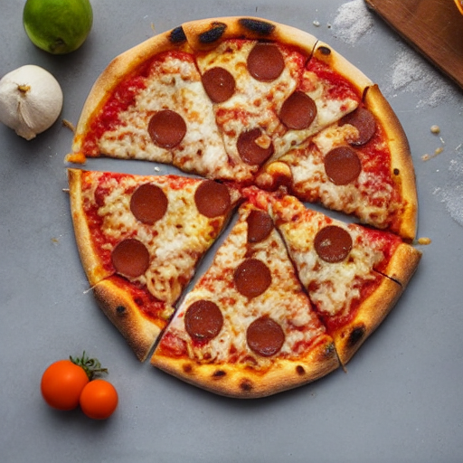
Deployment & run
Recipes to win
AzureML dev
Automated Training Pipeline
Data Validation
OpenShift dev
Data Preparation
Model Training
zoning
ocr
homography
Model Evaluation
Model Registry
Model Register
OpenShift rec
zoning
ocr
homography
OpenShift pre-prod
Docker registry
AzureML prod
zoning
ocr
homography
Automated Training Pipeline
OpenShift prod
Data Validation
Data Preparation
Model Training
zoning
ocr
homography
Model Evaluation
Model Registry
Model Register

Slide 78
Recipes to win
AzureML dev
Automated Training Pipeline
Data Validation
OpenShift dev
Data Preparation
Model Training
zoning
ocr
homography
Model Evaluation
Model Registry
Model Register
OpenShift rec
zoning
ocr
homography
OpenShift pre-prod
Docker registry
AzureML prod
zoning
ocr
homography
Automated Training Pipeline
OpenShift prod
Data Validation
Data Preparation
Model Training
zoning
ocr
homography
Model Evaluation
Model Registry
Model Register
Deployment & run

Slide 79
Recipes to win
AzureML dev
Automated Training Pipeline
Data Validation
OpenShift dev
Data Preparation
Model Training
zoning
ocr
homography
Model Evaluation
Model Registry
Model Register
OpenShift rec
zoning
ocr
homography
OpenShift pre-prod
Docker registry
AzureML prod
zoning
ocr
homography
Automated Training Pipeline
OpenShift prod
Data Validation
Data Preparation
Model Training
zoning
ocr
homography
Model Evaluation
Model Registry
Model Register
Deployment & run

Slide 80
Deployment & run
Recipes to win

Slide 81
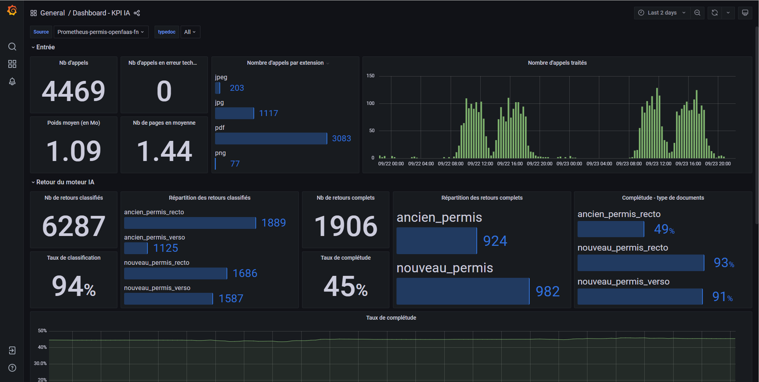
Recipes to win

Slide 82
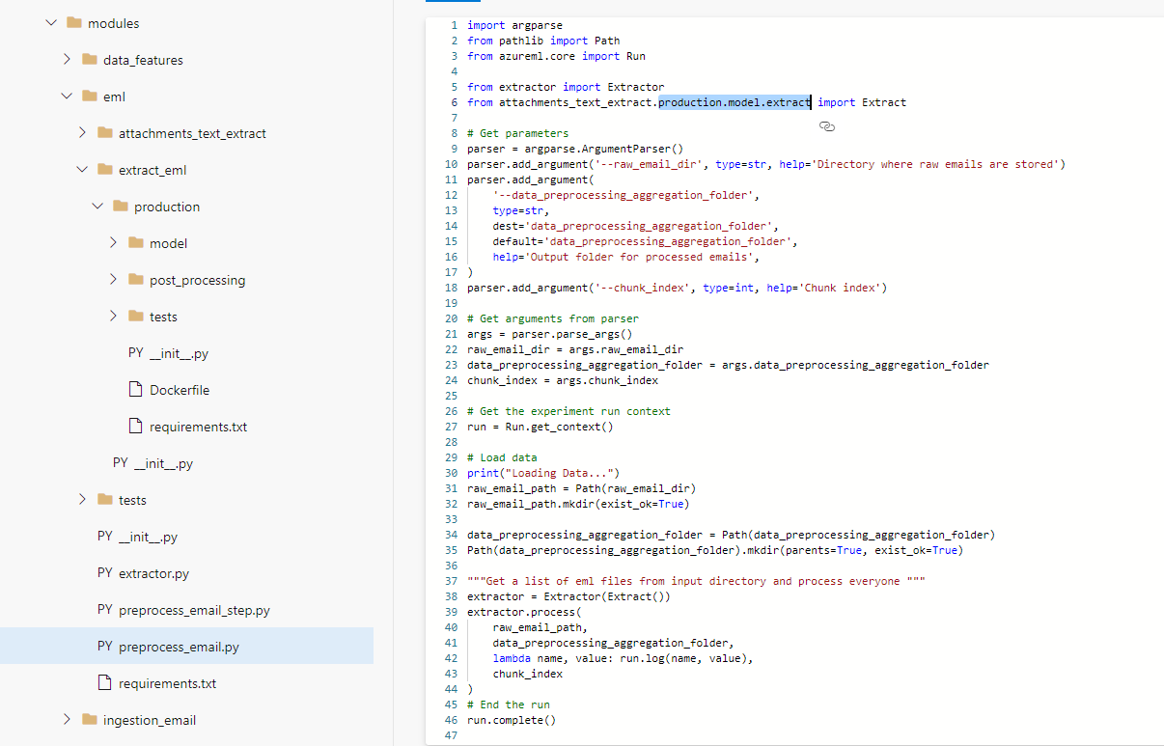

Slide 83
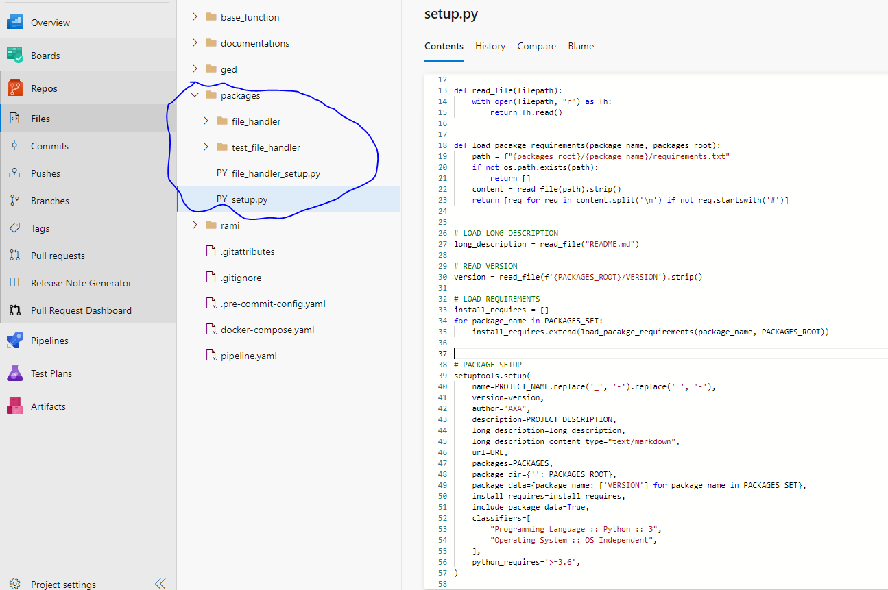

Slide 84
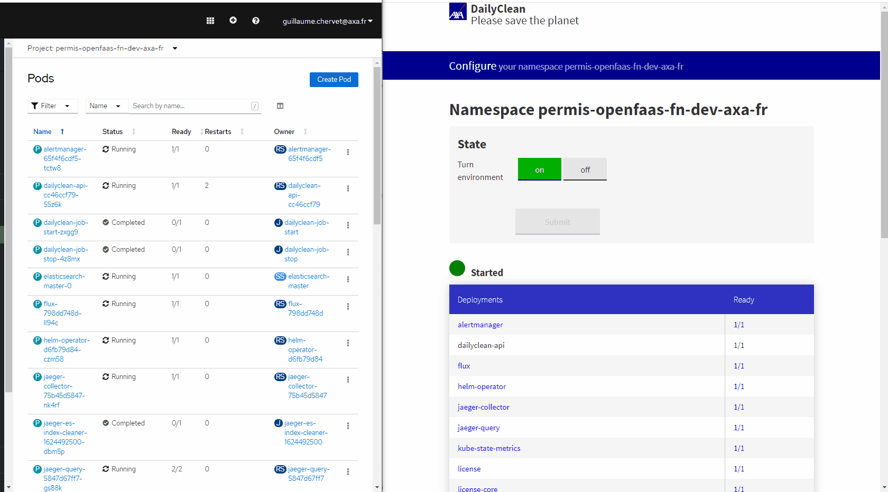
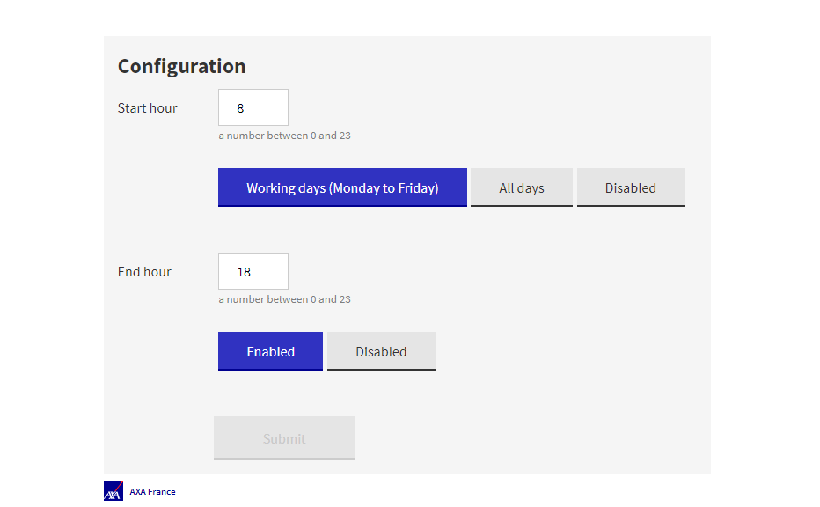

Slide 85

Conclusion
"three people hugging"

Slide 86
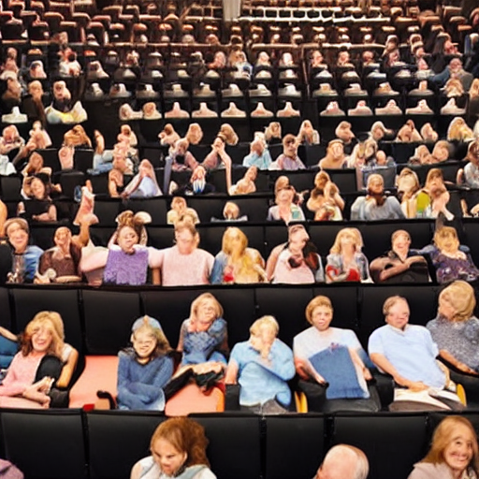
Merci ☺
"thank and hug the public in a theater"
Ecotag & Dailyclean :
https://github.com/AxaGuilDEv

Slide 89
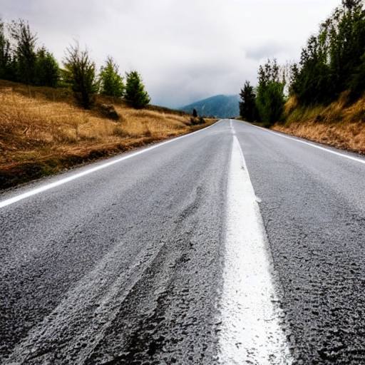


Slide 90
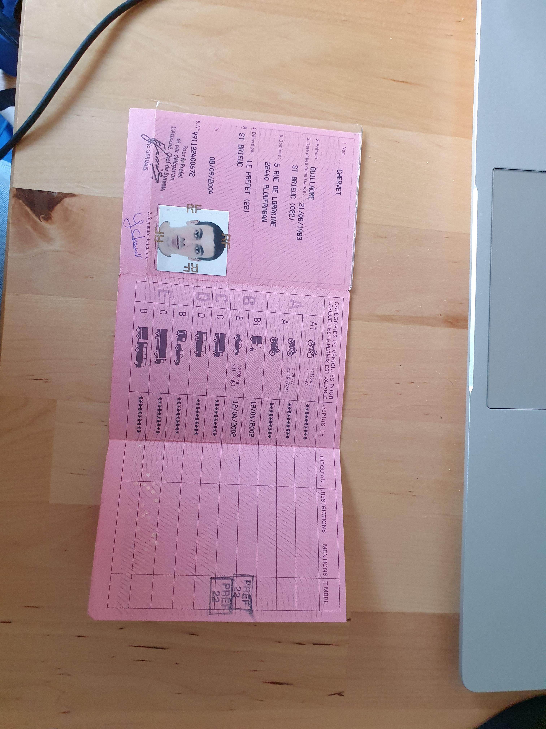

Production
OCR
Split
Zoning
Homography
Zoning
Classifier
Rotation
Zoning
OCR
Notes:
Guillaume
10 mins

Slide 91
Datasets
Feedbacks
File + annotations
Retrieve
Production application
Train IA
API call
Production IA
Deploy

Slide 92
Exploration
Industrialisation
Déploiement & run
Project timeline
Notes:
Exemple avec les rôles qui interviennent sur RAMI
Exemple aussi sur Clear
Exemple Carto

Slide 93
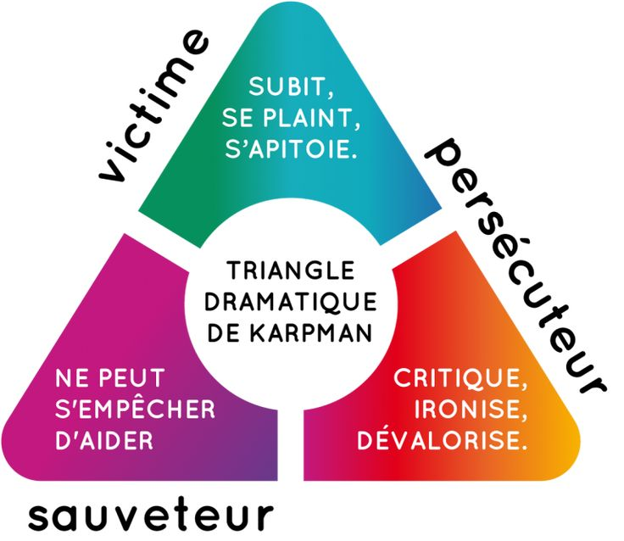
triangle de cartman
Notes:
- On passe de duo a trio
- On est dans l’innovation

Slide 96

Phase exploratoire : Est-que le projet est faisable ?
Phase production : Faire le projet.
Hot
"one potatoe with white smoke"
Notes:
Pas de versionning,
Pas d’industrialisation des scripts pour générer

Slide 97
Zoning
OCR
Rotation
Page
Zoning
Orientation
Rotation
Zoning
OCR
Split
Tensorflow
Split
Zoning
Orientation
Rotation
Zoning
OCR
Notes:
Guillaume
10 mins

Slide 98

Phase exploratoire : Est-que le projet est faisable ?
Phase production : Faire le projet.
Hot
"Data scientist cook with a suit in a kitchen, artstation concept art"
"developer waiter in t-shirt in a restaurant"
Notes:
Pas de versionning,
Pas d’industrialisation des scripts pour générer

Slide 99
OCR
Split
Zoning
Orientation
Zoning
Classifier
Rotation
Zoning
OCR
Tensorflow
Notes:
Guillaume
10 mins

Slide 100
Google: Un projet IA c’est d’abord du software Engineering

Slide 101
Agilité
On utilise une technologie associé à un besoin

Slide 102
Compétences nécessaire
J’annote : Tout le monde
J’entraine un modèle : Compétences IA, Software Engineering
Je valide le modèle : Compétences IA + Software Engineering
J’utilise le modèle : Compétences Software Engineering
Je code une application micro-service qui enchaîne des modèles : Compétences Software Engineering

Slide 103
Agilité
On utilise le deep learning uniquement si on en a besoin

Slide 104
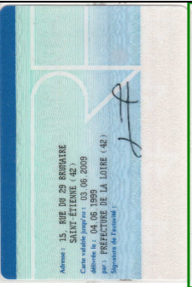
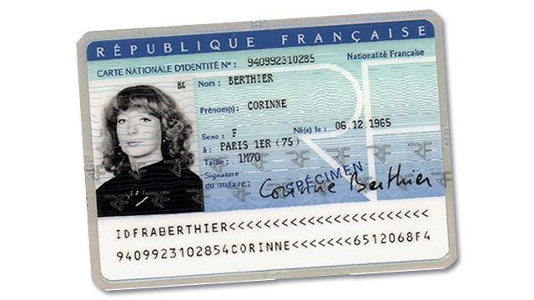
Page
Zoning
Straightening
Zoning
OCR
Split
Split
Zoning
Straightening
Zoning
OCR

Slide 105
Après refactorisation
Temps moyen « Ancien permis » : 18 secondes, après 9 secondes
Temps moyen « Nouveau permis » : 12 secondes, après 7 secondes
Plus de 12 000 € de gains par mois sur la production
6 modèles en moins à maintenir sur les 39 (dont 24 pour les ocr)
6 micro service en moins à maintenir sur les 16
Diminution de la dette technique
Tout en python 3.8
Tout tester unitairement
Plus de tensorflow 1
Plus de darknet copier/coller => tout en opencv
Meilleur taux de lecture
Algorithme moins déterministe

Slide 106
Pods | Algorithm | Actions | CUDA | Python | Nombre en prod | Mi/pod | Mi new/pod | Coût / mois/pod | Coût / mois
license |  |  |  | 3.8
license-ocr | tesseract 4.1.1 |  |  | 3.8 | 8 | 256 | 512 | 150 | +150
license-recto-verso-zoning | Darknet YOLOv3 | Ajout de marges Baisse la résolution des images injectées | 10.2 | 3.6 | 2 | 12130 | 1024 | 832,95 | - 1665,9
license-splitter | pdftoppm | Bascule a mupdf Extraction des images directement des pdfs Mise en place d’une taille max |  | 3.8 | 2 | 512
license-text-boxes | Tensorflow 1.x | Utilisation même algo en mode OpenCV CPU, python 3.8 | 10 | 3.6 | 2 | 8980 | 1024 | 670 | - 1183
new-license-info-recto-zoning | Darknet YOLOv3 | Utilisation OpenCV CPU Baisse qualité | 10.2 | 3.6 | 2 | 12130 | 1024 | 832,95 | - 1665,9
new-license-info-verso-zoning | Darknet YOLOv3 | Utilisation OpenCV CPU Baisse qualité | 10.2 | 3.6 | 2 | 12130 | 1024 | 832,95 | - 1665,9
new-license-orientation-recto | Tensorflow 2.x | Suppression | 10.1 | 3.6 | 2 | 4100 |  | 307,5 | - 615
new-license-orientation-verso | Tensorflow 2.x | Suppression | 10.1 | 3.6 | 2 | 4100 |  | 307,5 | - 615
new-license-rotation-recto | Tensorflow 2.x | Suppression | 10.1 | 3.6 | 2 | 5490 |  | 411,75 | - 823,5
new-license-rotation-verso | Tensorflow 2.x | Suppression | 10.1 | 3.6 | 2 | 5490 |  | 411,75 | - 823,5
old-license-info-recto-zoning | Darknet YOLOv3 | Utilisation OpenCV CPU Baisse qualité | 10.2 | 3.6 | 2 | 12130 | 1024 | 832,95 | - 1665,9
old-license-orientation-recto | Tensorflow 2.x | Suppression | 10.1 | 3.6 |  | 4100 |  | 307,5 | - 615
license-core | OpenCV 2.x |  |  | 3.8 | 2 | 1024
old-license-recto-table-classifier | Tensorflow 2.x | Suppression | 10.1 | 3.6 |  | 4100 |  | 307,5
Total : |  |  |  |  |  |  |  |  | -11 348

Slide 107
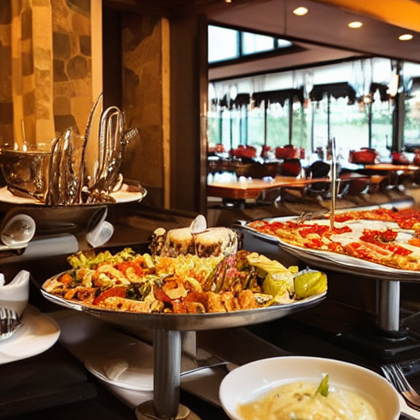
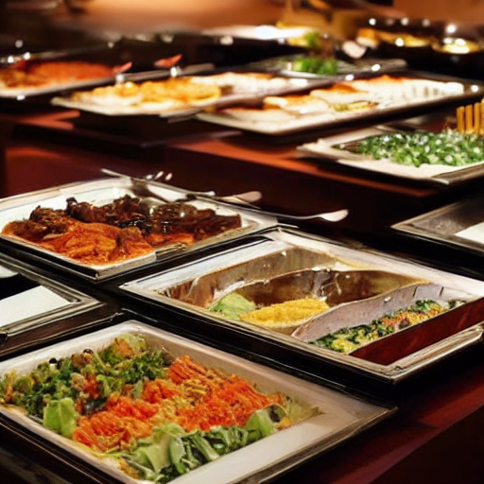

Slide 108
PDF, IMAGES
OCR
Callback HTTP
Input callback HTTP
Receiver
Nouveau permis recto
Queue
Orientation
Orientation
Zoning
Queue
Queue
Queue
Queue
Zoning Tableau
Splitter
Nouveau permis verso
Orientation
Rotation
Zoning
Rotation Tableau
Queue
Queue
Queue
Queue
Queue
Queue
Zoning
Ancien permis recto
Orientation
Zoning
Classifier Tableau
Rotation Tableau
Queue
Queue
Queue
Queue

Slide 109
Type d’algorithme
Deep Learning
Machine
Learning
Code classique
Itération rapide
Résilient aux changements
Peux couteux en temps/RAM/CPU
Ne pourra pas couvrir 100% des cas
Réutilisable
Algorithmes pas tous déterministe
Itération Longue
Peu résilient aux changements
Couteux en temps/RAM/CPU
Couvrira les cas simple (structuré)
Itération très longue
Peu résilient aux changements
Très couteux en temps/RAM/CPU
Permet de tendre vers une couverture fonctionnelle de 100% des cas

Slide 110
Suite refactorisation
Avec un peu d’effort, on peut encore gagner
1 à 5 secondes de temps de traitement
Environ encore 3000 €/mois en production
Tâches
Rendre les OCR résiliant à la qualité du zoning en amont (afin de pouvoir baisser la qualité des zoning)
Basculer les darknet GPU sur de l’OpenCV GPU ou CPU (Unification des librairies, stream mémoires des fichiers sans écriture disque, simplification technique)
Remplacement de « license-text-boxes » (qui ne peut pas être mis à jour et utilise un clone d’un git pas maintenu depuis 2 ans) remplacer par du traitement d’image (ou autre)
Suppression de « old-license-recto-table-classifier ». Réaliser la classification des anciens permis depuis le tout premier zoning (augmenterais la qualité de tous les traitements d’après)
Etudier suppression de new-license-info-recto-zoning
Etudier suppression de new-license-info-verso-zoning
Valider les prénoms/prénoms/villes en utilisant les donnée de l’insee un CER
Améliorer les nouveaux algorithmes de traitement d’image
Tester de remettre les tensorflow en mode CPU (Utilise moins de mémoire en mode CPU)

Slide 111

78%
Page
Zoning
Homography
Zoning
OCR
85%
Split
Split
Zoning
Homography
Zoning
OCR
Notes:
Guillaume
10 mins

Slide 112
Experimentation phase
Choose an ML and/or classical algorithm and code your model
Tune the model hyperparameters
Identify problem and collect and analyse data
Transform data
&
annotate
Experiment with data and model training
Iterate Tuning and training

Slide 113
Recipes to fail
"one potatoe with white smoke"
Notes:
Pas de versionning,
Pas d’industrialisation des scripts pour générer

Slide 114
Production phase
Transform data
&
annotate
Monitor the model’s performances
Train
&
validate
Serve in production
Iterate Tuning and training

Slide 115
Un projet complexe chaînant plusieurs algorithmes de DeepLearning c’est bien, un projet ML qui fonctionne en production, c’est encore mieux :] Qui fonctionne en production ? Exécution rapide, Qualité de prédiction identique entre l’entrainement et la production, Monitoré et re-livrable très rapidement en cas de problème, Pas trop cher et vous rapporte des sous Bref un projet qui répond aux besoins des utilisateurs ! Le constat est que beaucoup de projets ML échouent à l’étape : passer en production, pour plusieurs raisons que nous détaillerons. Nous représenterons les étapes de l’entrainement d’un ou plusieurs algorithmes IA. Puis nous vous ferons un retour d’expériences sur nos échecs riches en apprentissages et bien sûr nos succès c’est-à-dire des projets en production qui dépotent. Cette présentation s'adresse à tout public (Développeur, DataScientist, Ops, Manageur, etc..)

Slide 116
Pas de versionning, pas d’industrialisation des scripts pour générer
Pas faire travailler les gens ensemble
DS => ne pas se fié au besoin => pas de test unitaire => pas de métrique => se focaliser sur les statistiques => Faire de que l’IA First
Dupliquer le code

Slide 117
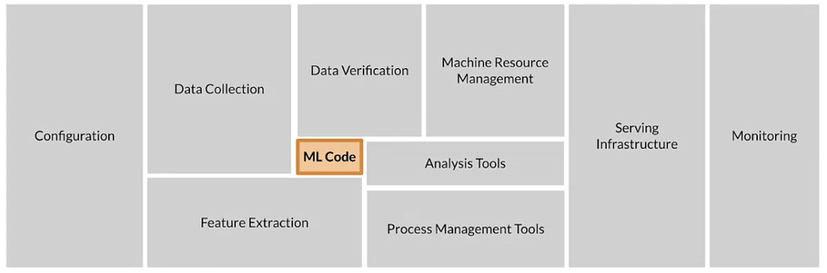

Slide 118
Use Deep Learning Everywhere
Deep Learning
Code classique
"bottle of beer with a pig on the label"
"bottle of champagne gold"
Notes:
Code classique
Itération rapide
Résilient aux changements de la données
Peux couteux en temps/RAM/CPU
Ne pourra pas couvrir 100% des cas
Réutilisable
Algorithmes pas tous déterministe
Deep Learning :
Itération très longue
Peu résilient aux changements
Couteux en temps/RAM/CPU
Permet de tendre vers une couverture fonctionnelle de 100% des cas
Tester les modèles générique déjà pré-entrainer sur internet

Slide 119
Architecture
Monolithe
Micro service
Fast iteration
Very slow iteration

Slide 120
Recipes to fail
Exploration
Industrialisation
Deployment & run
"Data scientist girl who cook with a suit in a kitchen, artstation concept art"
"Developer waiter in t-shirt in a restaurant , artstation concept art"
"Man who washes dishes in a kitchen, artstation concept art"
Project timeline
Notes:
Exemple avec les rôles qui interviennent sur RAMI
Exemple aussi sur Clear
Exemple Carto

